Slide 1
DESIGN AND IMPLEMENTATION OF A MOBILE-BASED ARCHIVAL AND RETRIEVAL OF MISSING OBJECTS APPLICATION USING IMAGE MATCHING
task 4: system design and modelling
Group one

Slide 2
OUTLINE
INTRODUCTION
SYSTEM DESIGN AND MODELLING:
SYSTEM ARCHITECHTURE DESIGN
CONTEXT DIAGRAM
USECASE DIAGRAM
SEQUENCE DIAGRAM
CLASS DIAGRAM
DEPLOYMENT DIAGRAM
CONCLUSION

Slide 3
I. INTRODUCTION

Slide 4
II. SYSTEM MODELLING AND DESIGN

Slide 5
SYSTEM ARHITECTURE
Layers
Components
Sub-modules

Slide 6
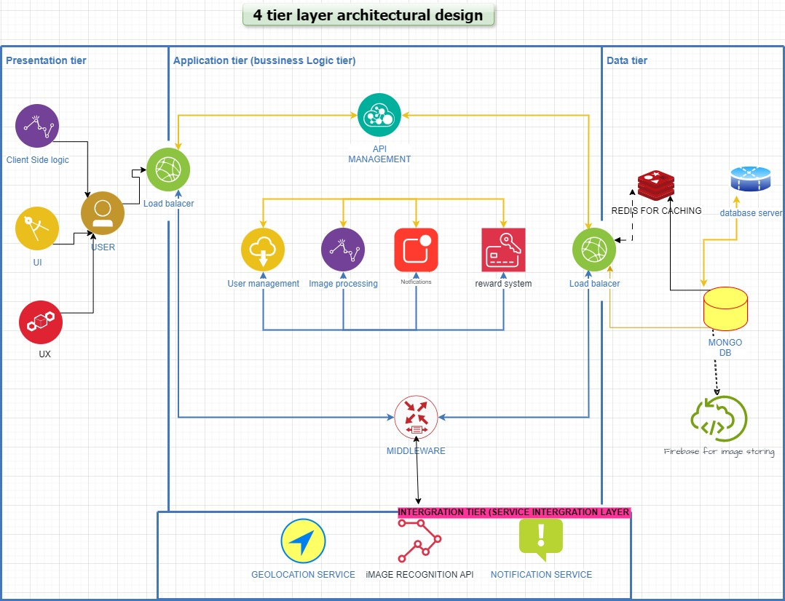

Slide 7
CONTEXT DIAGRAM
System
External actors
Interactions

Slide 8
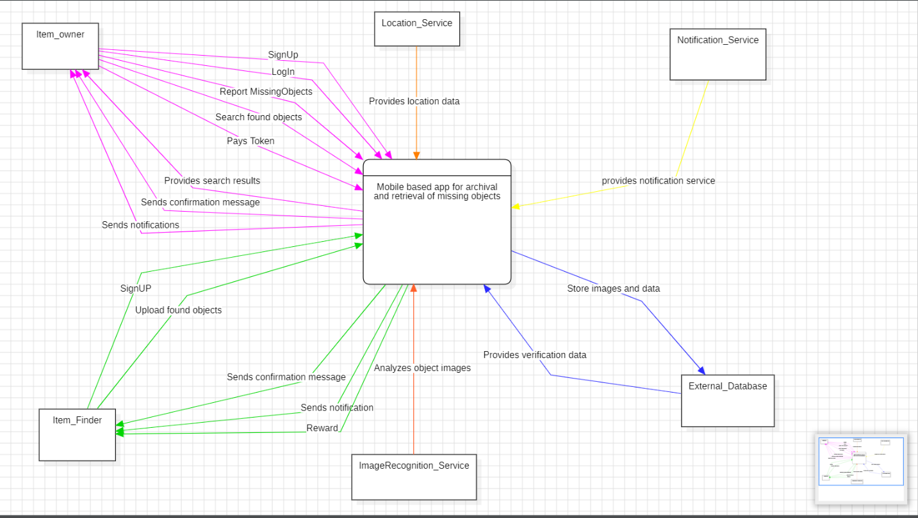

Slide 9
USECASE DIAGRAM
System
Actors
Use-cases
Relationships

Slide 10
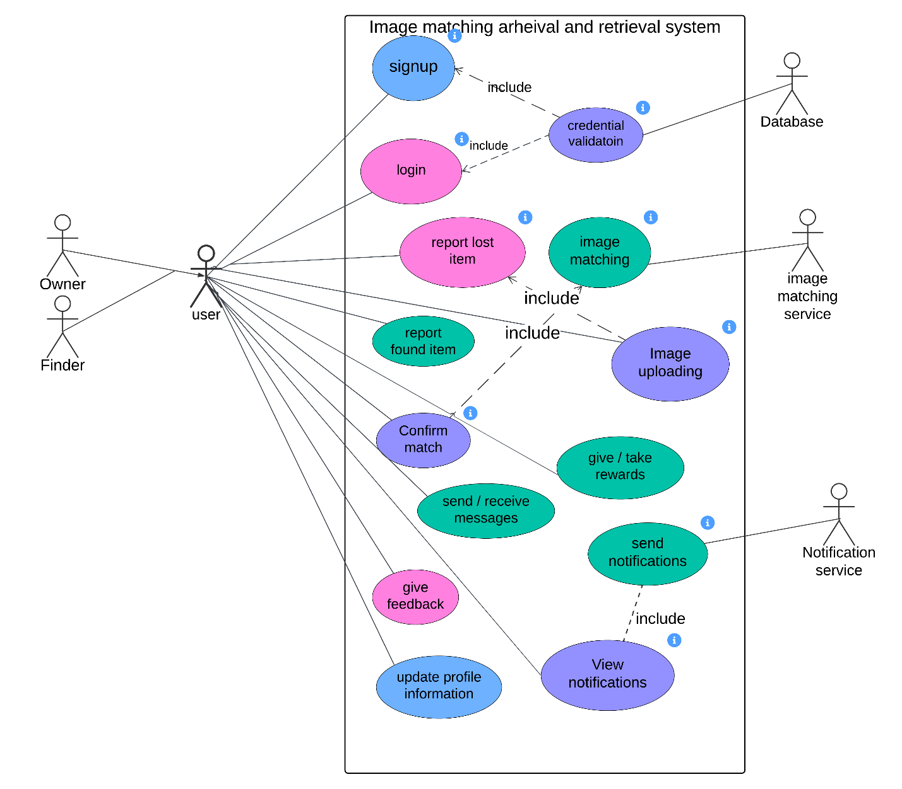

Slide 11
SEQUENCE DIAGRAM
Participants (entities)
Sequencing (order)
Interactions
Messages

Slide 12
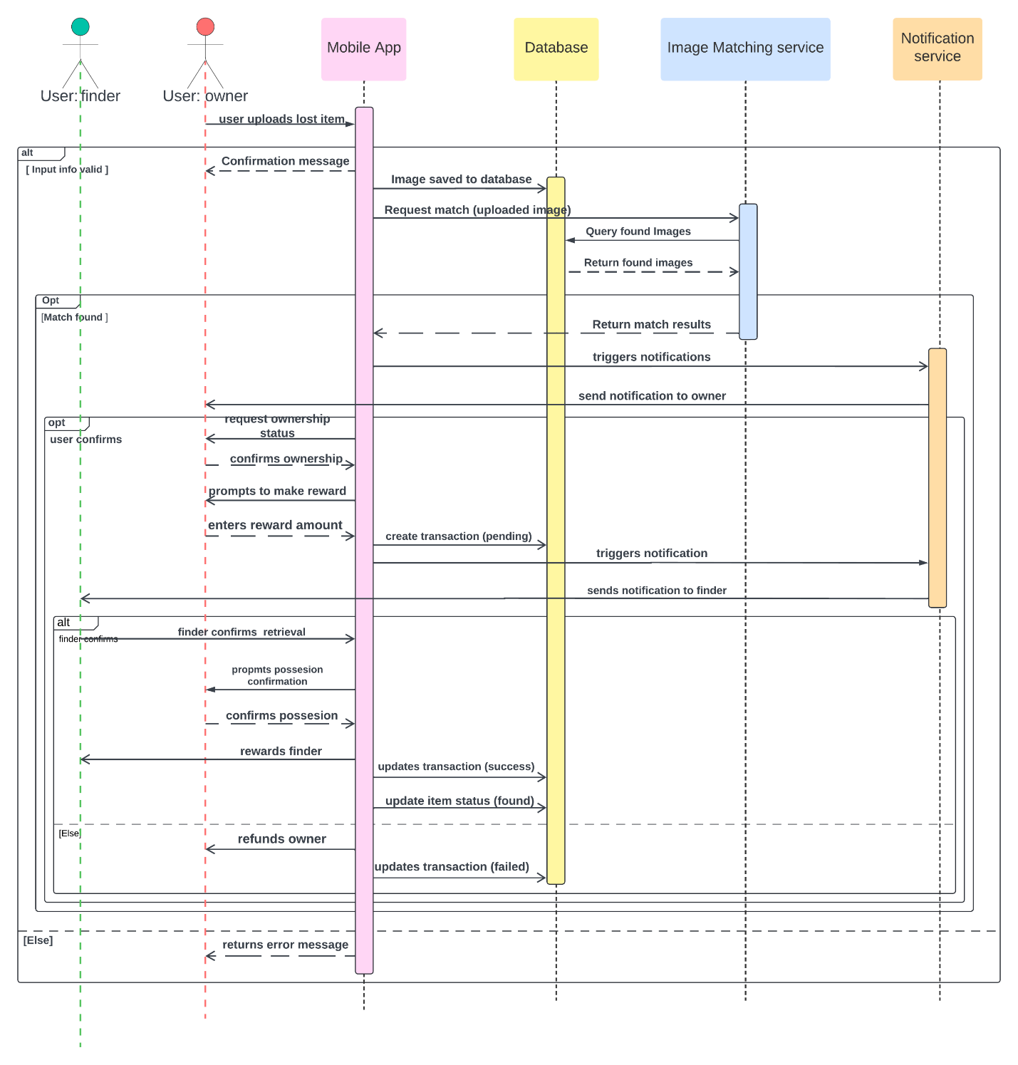

Slide 13
CLASS DIAGRAM
Classes (entities)
Attributes / methods
Associations
Multiplicities

Slide 14
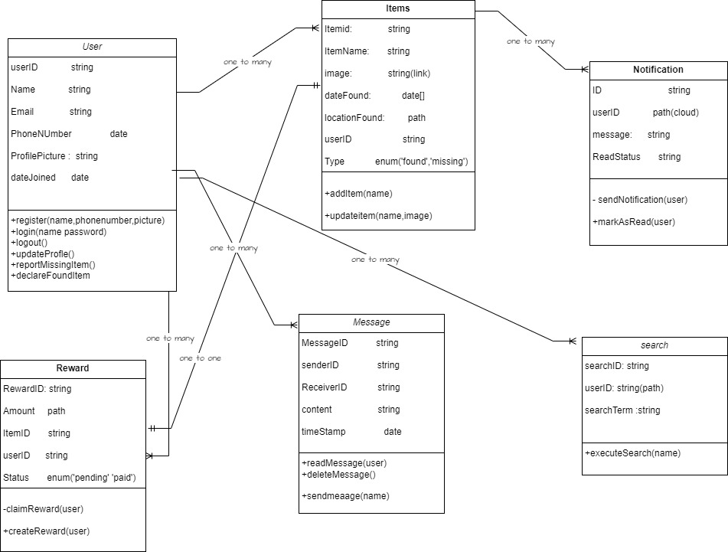

Slide 15
DEPLOYMENT DIAGRAM
Nodes
Components
Communication paths

Slide 16
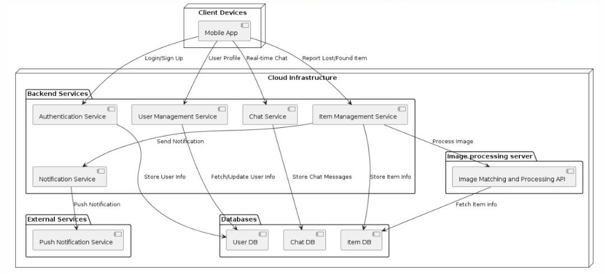

Slide 17
CONCLUSION

Slide 18
THANK YOU

Slide 19
END
NAME | MATRICULE
MEWOABI NGUEFACK DORE | FE21A239
ALEANU NTIMAEH ENOW | FE21A134
OJONG-ENYANG OYERE | FE21A297
FONGANG KELUAM PAUL DIEUDONNE | FE21A193
TANWIE BRUNO ADEY | FE21A316

